Slide 1

ATP: In-network Aggregation for Multi-tenant Learning
Chonlam Lao*, Yanfang Le*, Kshiteej Mahajan, Yixi Chen, Wenfei Wu, Aditya Akella, Michael Swift
Tsinghua University
University of Wisconsin-Madison
* = co-primary ¹authors

Slide 2



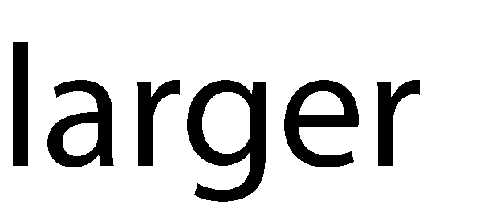
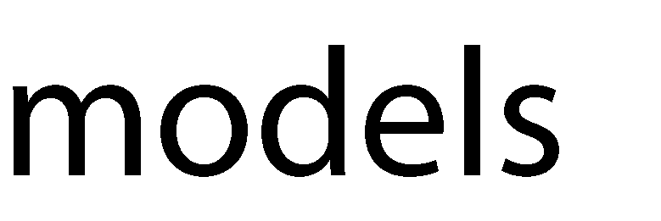

Background and motivation
Machine learning
1
Innovation fueled by leaps in (costly) infrastructure:
Clusters with hundreds of machines, each with many HW accelerators (GPUs)
Compute requirements doubling every 3 months!
Training models is still very time-consuming: days or even weeks!

Slide 3






Background and motivation
Existing methods
Parameter Server (PS)
Parameter Servers (PS)
PS 1
$$a^{′}=a_{1}+a_{2}+a_{3}+a_{4}$$
Network could be bottleneck for distributed training
Workers
a₁ b₁
Worker1
$$a^{′}$$
$$a^{′}$$
$$a^{′}$$
a₂ b₂
Worker2
a₃ b₃
Worker3
a₄ b₄
Worker4
$$a^{′}$$
Gradients

Slide 4


Trend of In-network Computation
Programmable switch offers in-transit packet processing and in- network state
Packet Ingress
Packet Egress
Traffic Manager
3

Slide 5
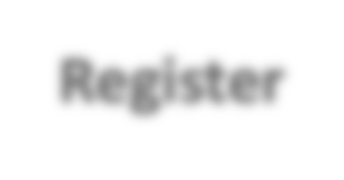
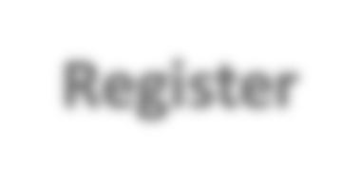


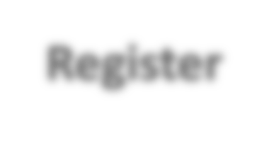






Trend of In-network Computation
Programmable switch offers in-transit packet processing and in- network state
Reduce training time by moving gradient aggregation into the network
Packet Ingress
Packet Egress
Register
Register
Traffic Manager
Register
Register
3

Slide 6
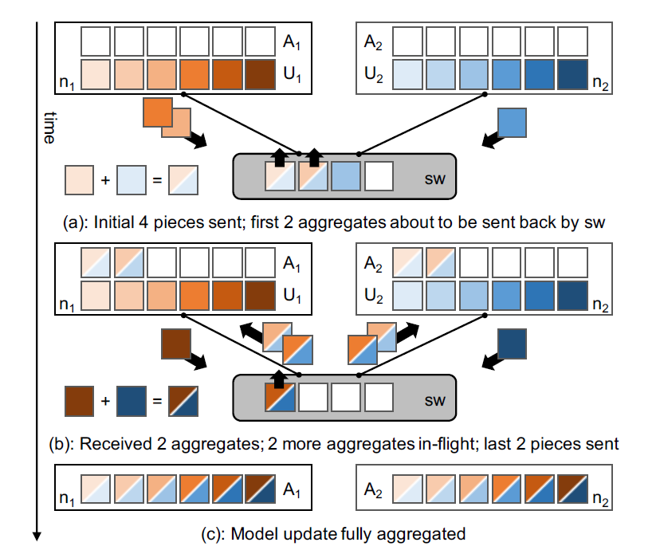
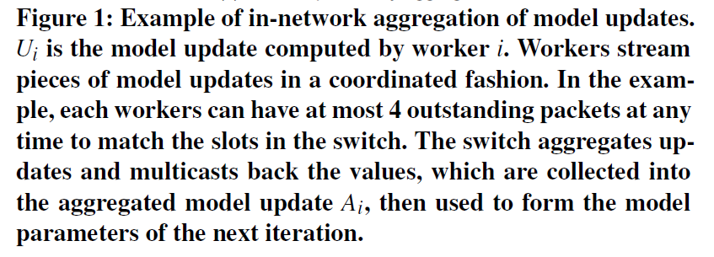
In-network aggregation - SwitchML

Slide 7
In-network aggregation - SwitchML
Target single-rack settings
Support multiple jobs by static partitioning of switch resources
Shortcomings
Inefficiently use the switch resources
Does not consider multi-rack settings
40
35
30
25
20
15
10
5
0
Throughput (Gbps)
0
250
500
750
Time(ms)
1000
1250

Slide 8
Key Goal
Speed up multiple DT jobs in a cluster while maximizing the benefits from in-network multi-switch aggregation

Slide 9
Outline
Multi-tenant
Multi-rack
Additional challenges
Reliability
Congestion control
Improve floating point computation
Evaluation

Slide 10

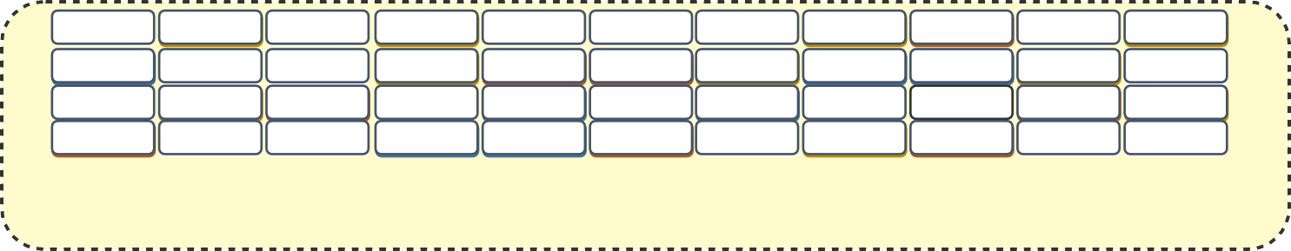
Multi-tenant: dynamic allocation
Objective: maximize switch resource utilization
Key idea: dynamic allocation in per-packet level
Randomly hash gradient packets to whole memory
Aggregator
Switch
7

Slide 11
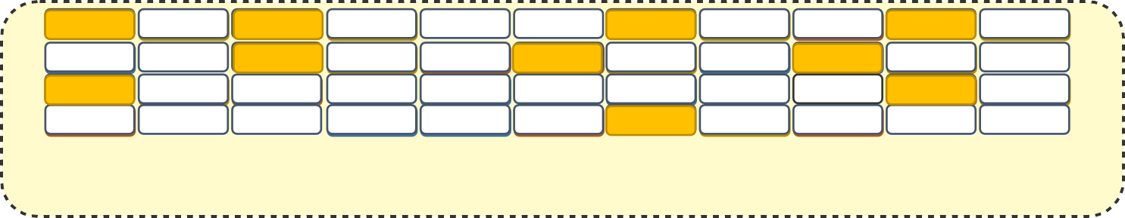
Multi-tenant: dynamic allocation
Objective: maximize switch resource utilization
Key idea: dynamic allocation in per-packet level
Randomly hash gradient packets to whole memory
Aggregator
Aggregator
Job 2
Worker 1
Worker 2
......
Worker n
Switch
Job 2
PS
7

Slide 12
Multi-tenant: dynamic allocation
Objective: maximize switch resource utilization
Key idea: dynamic allocation in per-packet level
Randomly hash gradient packets to whole memory
Aggregator
Aggregator
Job 2
Worker 1
Worker 2
......
Worker n
Switch
Job 2
PS
7

Slide 13
Multi-tenant: dynamic allocation
Objective: maximize switch resource utilization
Key idea: dynamic allocation in per-packet level
Randomly hash gradient packets to whole memory
Aggregator
Aggregator
Job 2
Worker 1
Worker 2
......
Worker n
Switch
Job 2
PS
7

Slide 14
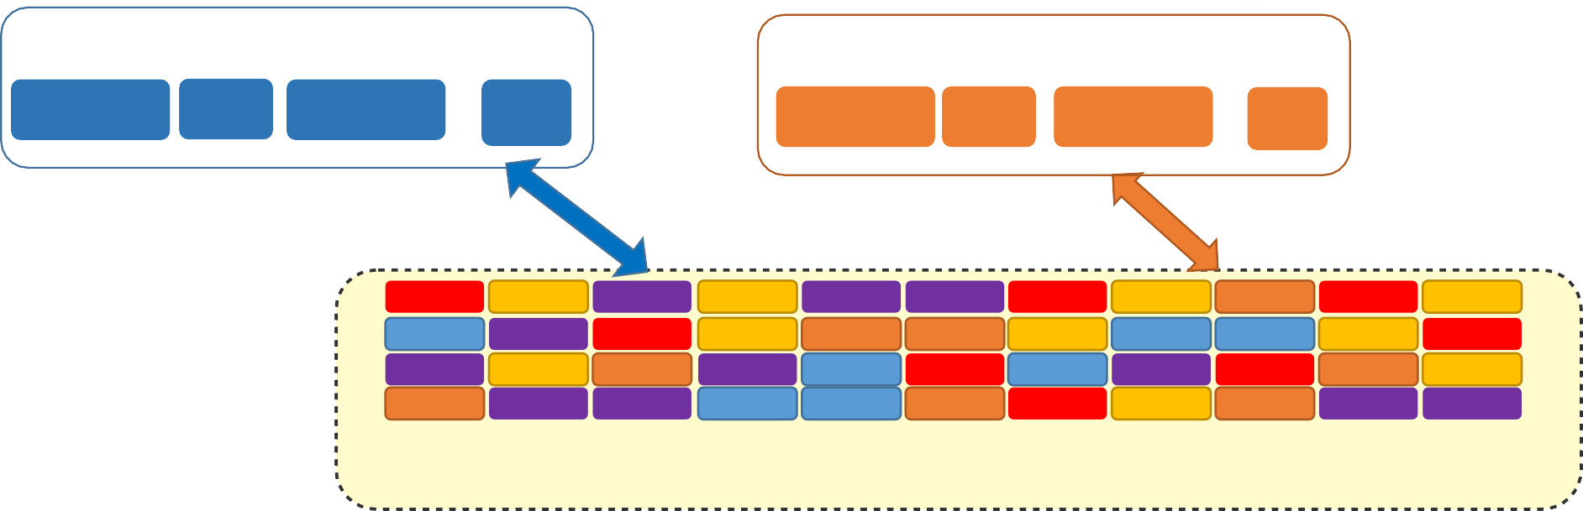
Challenge 1: Heavy Contention
Job 3
Worker 1 ......
Job 1
Worker 1
Worker n
PS
PS
Best-effort
......
Worker n
Job 2
Worker 1
Worker 2
Switch
......
Worker n
Job 2
PS
9

Slide 15
Challenge 1: Heavy Contention
Job 3
Worker 1 ......
Job 1
Worker 1
Worker n
PS
PS
Best-effort
......
Worker n
Job 2
Worker 1
Worker 2
Switch
......
Worker n
Job 2
PS
9

Slide 16
Challenge 2: Incomplete Aggregation
Job 3
Worker 1 ......
Job 1
Worker 1
Worker n
PS
......
Worker n
PS
Job 2
Worker 1
Worker 2
Switch
......
Worker n
Job 2
PS
9

Slide 17


Challenge 2: Incomplete Aggregation
Job 3
Worker 1 ......
Job 1
Worker 1
Worker n
PS
......
Worker n
PS
Job 2
Worker 1
$$a_{1}$$
Worker 2
Switch
......
Worker n
Job 2
PS
$$a_{1}$$
9

Slide 18





Challenge 2: Incomplete Aggregation
Job 3
Worker 1 ......
Job 1
Worker 1
Worker n
PS
......
Worker n
PS
Job 2
Worker 1
$$a_{2}$$
Worker 2
$$a_{⋯}$$
Switch
......
Worker n
$$a_{n}$$
$$a_{2}+⋯+a_{n}$$
Job 2
PS
$$a_{1}$$
9

Slide 19
Challenge 2: Incomplete Aggregation
Job 3
Worker 1 ......
Job 1
Worker 1
Worker n
PS
......
Worker n
PS
Job 2
Worker 1
b
c
d
Worker 2
Switch
......
Worker n
$$a_{2}+⋯+a_{n}$$
Job 2
PS
$$a_{1}$$
9

Slide 20
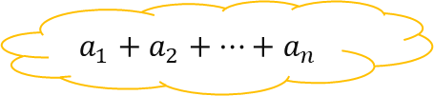

Challenge 2: Incomplete Aggregation
Job 3
Worker 1 ......
Job 1
Worker 1
Worker n
PS
......
Worker n
PS
b
c
d
Job 2
Worker 1
$$a_{1}$$
$$a_{2}$$
Worker 2
$$a_{⋯}$$
Switch
......
Worker n
$$a_{n}$$
$${a_{1}+a}_{2}+⋯+a_{n}$$
retransmission
Job 2
PS
9

Slide 21
Inter-Rack Aggregation
Aggregation at every layer of network topology
Nondeterministic routing, i.e., ECMP
Support two-level aggregation at ToR switches
Workers and PS(es) locate in different racks
Scale up to 1024 workers
Datacenter Network
SW1
SW2
SW3
a1
a2
a3
a4
a5
a6
W1
W2
W3
W4
W5
W6
PS
14

Slide 22
Inter-Rack Aggregation
Aggregation at every layer of network topology
Nondeterministic routing, i.e., ECMP
Support two-level aggregation at ToR switches
Workers and PS(es) locate in different racks
Scale up to 1024 workers
Datacenter Network
SW1
SW2
SW3
a2
a4
a6
W1
W2
W3
W4
W5
W6
PS
14

Slide 23
Inter-Rack Aggregation
Aggregation at every layer of network topology
Nondeterministic routing, i.e., ECMP
Support two-level aggregation at ToR switches
Workers and PS(es) locate in different racks
Scale up to 1024 workers
Datacenter Network
SW1
SW2
SW3
a1’+a2’+a5+a6
W1
W2
W3
W4
W5
W6
PS
14

Slide 24
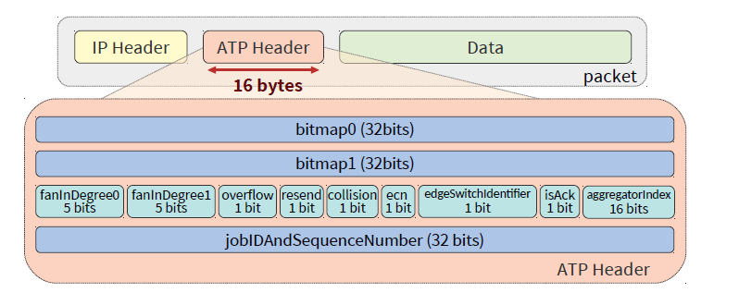
ATP infrastructure setup
ATP packet format
Worker’s position in the aggregation hierarchy
First-level switch’s position at the second edge
switch
fanInDegree0: the number of workers attached to the first edge switch
fanInDegree1: the number of switches attached to the second edge switch
edgeSwitchIdentifier=0: packet is en-route to the first edge switch
edgeSwitchIdentifier=1: packet is en-router to the second edge switch

Slide 25
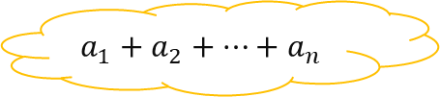




Reliability and congestion control
Reliability
Packet loss
Retransmission the previous packet after receiving three consecutive parameter other than the expected sequence number
Set resend bit set
Job 3
Worker 1 ......
Job 1
Worker 1
Worker n
PS
......
Worker n
PS
b
c
d
Job 2
Worker 1
$$a_{1}$$
$$a_{2}$$
Worker 2
$$a_{⋯}$$
Switch
......
Worker n
$$a_{n}$$
$${a_{1}+a}_{2}+⋯+a_{n}$$
retransmission
Job 2
PS

Slide 26
ATP infrastructure setup
ATP packet format

Slide 27
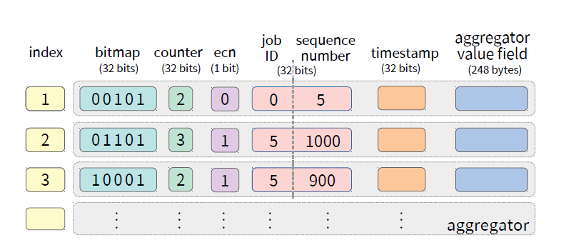
ATP switch memory layout
The bitmap field records which workers have already been aggregated to the aggregator’s value field.

Slide 28
Reliability and congestion control
Congestion control
ECN marks as the primary congestion signal
Explicit Congestion Notification (ECN)
ECN is marked in switches
ECN notifies workers about the congestion status
Packet loss
When receiving congestion signals, ATP adjusts window sizes
Improve the floating-point computation
Convert gradients to 32-bit integer at workers by a scaling factor

Slide 29
ATP Implementation and Evaluation
Implementation
Replace the networking stack of BytePS at the end host
BytePS is a high performance and general distributed training framework
Use P4 to implement the in-network aggregation service at Barefoot Tofino switch
Evaluation
Setup: 9 servers, each with one GPU, one 100G NIC
Baseline: ( BytePS + TCP, BytePS+ RDMA ) x (Nto1, NtoN ), SwitchML, Horovod+RDMA, Horovod+TCP
BytePS uses worker-PS architecture
Horovod: a ring all-reduce architecture
Metrics: Training Throughput, Time-to-Accuracy
Workloads: AlexNet, VGG11, VGG16, VGG19, ResNet50, ResNet101, and ResNet152
16

Slide 30
Evaluation
How does ATP perform compared to state-of-the-art approaches for a single job? (Part 1)
How does ATP’s inter-rack aggregation perform compared to an alternate rack-scale service (Part 2)
What are the overheads of ATP’s loss recovery mechanisms (Part 3)
How does conversion to integers in ATP affect time to accuracy (Part 4)
How does dynamic aggregator allocation compare to a centralized static scheme under multi-tenancy (Part 5)
How effective is ATP’s congestion control (Part 6)

Slide 31
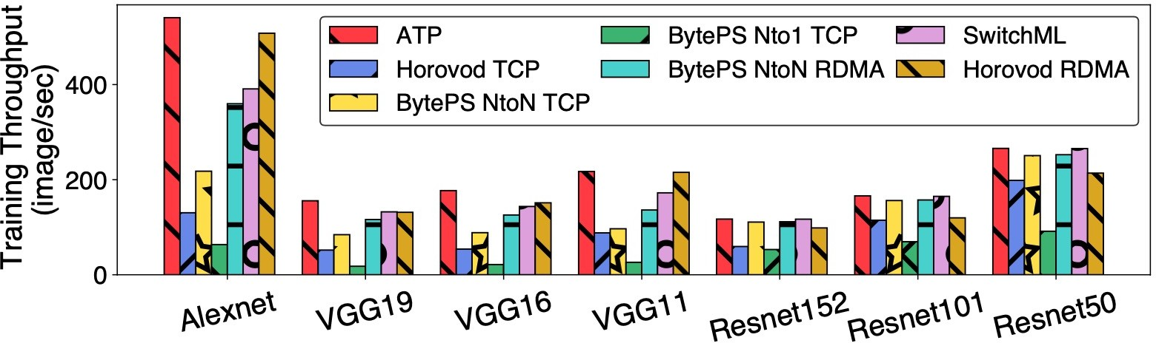
Part 1: Single Job Performance
ATP achieves the best performance compared to all other methods for all jobs
ATP gets larger performance gains on network-intensive workloads (VGG) than the computation-intensive workloads (ResNet).
17

Slide 32
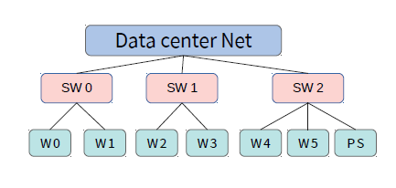
Part 2: Multi-rack performance
PS with RSS receives 3X more traffic
than PS with ATP.
Multi-rack topology

Slide 33
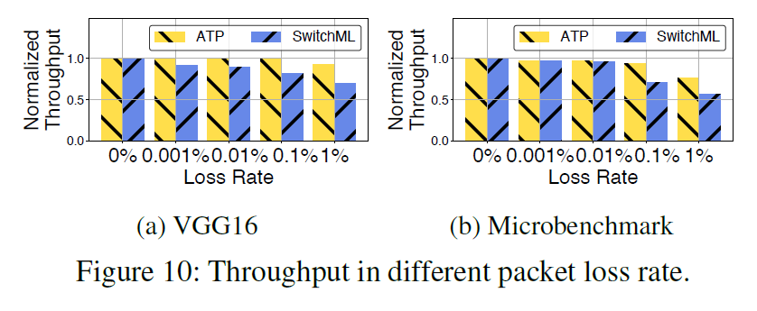
Part 3: Packet loss recovery overhead
Throughput is normalized to no loss for varying loss rates

Slide 34
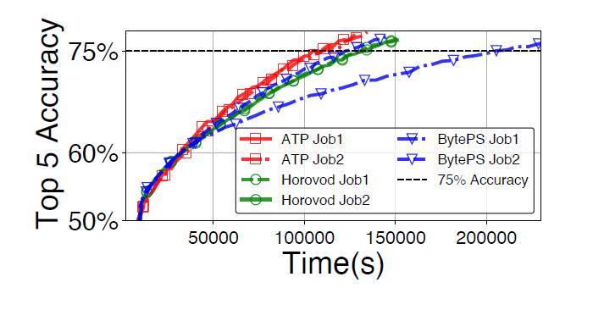
Part 4: Time-to-Accuracy (TTA)
TTA with two VGG16 jobs
ATP outperforms BytePS and Horovod and reaches 75% top-5 accuracy 1.20X faster than the fastest BytePS job, and 1.25X faster than Horovod

Slide 35
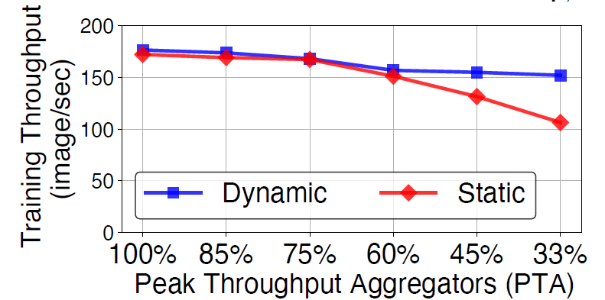
Part 5: Multiple Jobs: dynamic (ATP) vs static
3 VGG16 Jobs
Static approach evenly distributes aggregators to jobs
PTA: the number of the aggregators to make each job to achieve the peak aggregation throughput
When switch memory is sufficient, ATP’s dynamic $≈$ static
When switch memory is insufficient, ATP’s dynamic $>$ static
18

Slide 36
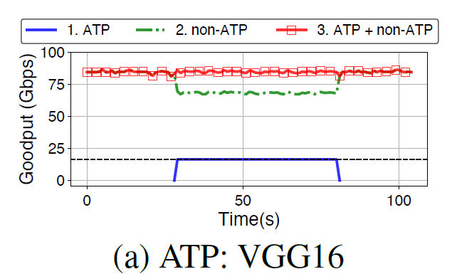
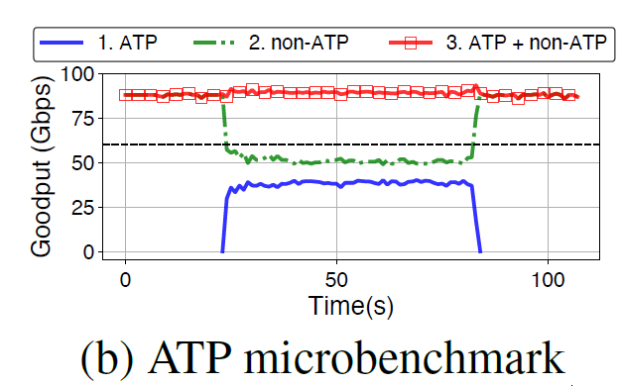
Part 6: Effectiveness of ATP’s congestion control
The congestion control of ATP can respond quickly to changes in congestion, and converge to a new bandwidth which is very stable.

Slide 37
ATP
Summary
A network service that supports best-effort, dynamic in-network aggregation aimed at multi-rack, multi-tenant
Co-design end-host and switch logic
Reliability
Congestion control
Dealing with floating point
Opensource: https://github.com/in-ATP/ATP
19

